Slide 1
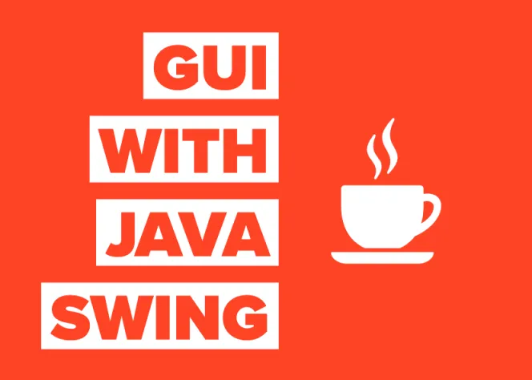
Java Swing

Slide 2

Contents
History of GUI using Java
Swing Introduction
Components
Creating a Swing Program

Slide 3
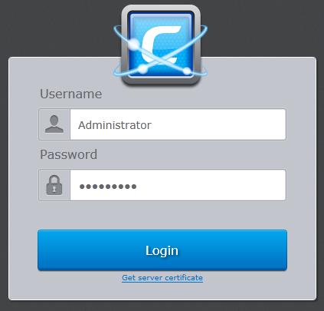
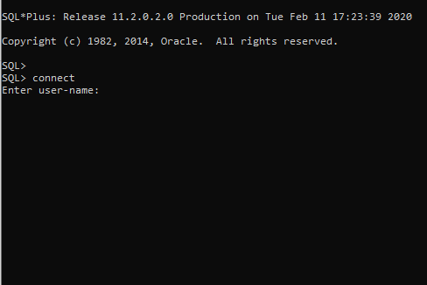
Which one is better?
Graphical User
Interface
Command Line
Interface

Slide 4
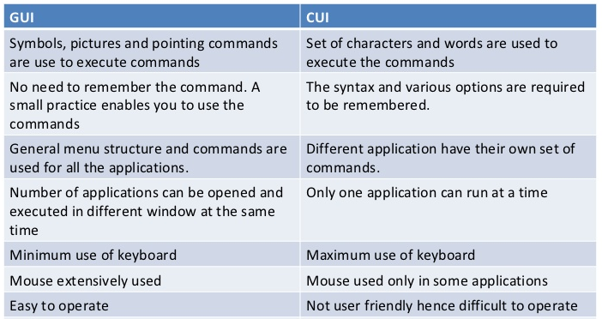
Difference between
GUI and CLI

Slide 5

History of GUI using Java
AWT
Abstract Window Toolkit
Introduced with JDK 1.0
Swing
Introduced with Java 2
Light weighted
JavaFX
Introduced with Java 8
Includes Animations
Heavy weighted
Event Handling
Identical on Different Platforms
Inherits AWT
Modern UI

Slide 6

Java Swing

Slide 7
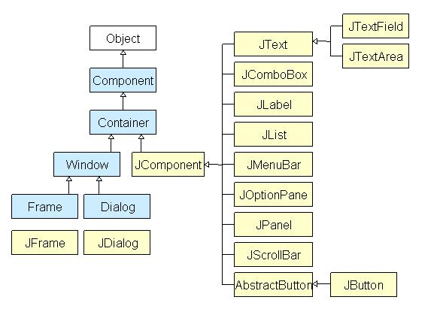
Java Swing
Java Swing is a lightweight Graphical User Interface (GUI) toolkit that includes a rich set of widgets.
It includes package lets you make GUI components for your Java applications
It is platform independent.
The Swing library is built on top of the AWT.
What is a container class?
Container classes are classes that can have other components on it. So for creating a GUI, we need at least one container object.

Slide 8
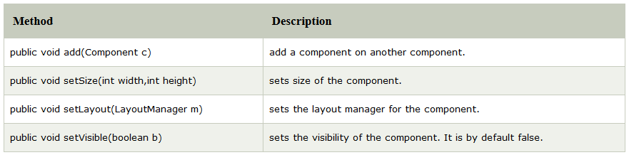
Java Swing (contd..)
Types of Containers
Panel: It is a pure container and is not a window in itself. The sole purpose of a Panel is to organize the components on to a window.
Frame: It is a fully functioning window with its title and icons.
Dialog: It can be thought of like a pop-up window that pops out when a message has to be displayed. It is not a fully functioning window like the Frame.

Slide 9




Components of Swing
Jbutton is a class that provides functionality of a button.
JTextField is used for taking input of single line of text. It is most widely used text component.
JCheckBox class is used to create checkboxes in frame.
JRadioButton class is used to create a radio button in Frames.
JComboBox component is used to create a combo box in Swing.

Slide 10
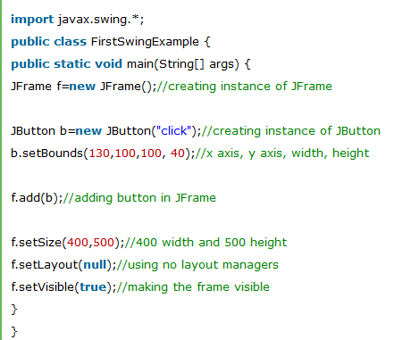
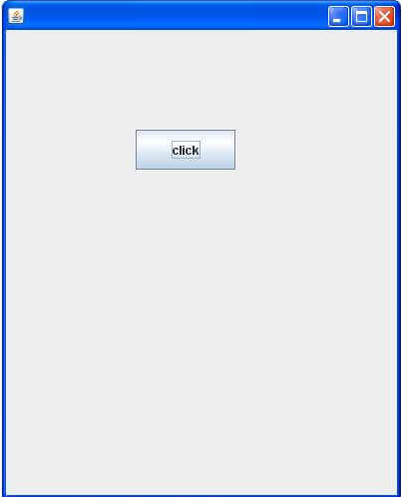
Creating a Swing Program
Code
Output

Slide 11
Lets Recall..
Comparison of GUI and CLI
Swing Introduction
Components like Jbutton, Jtextfield , Jcombobox etc.
Creating a basic Swing Program

Slide 12


